Slide 1
Third Quarter Life Bible Study
August 9, 2026

Slide 2
He Left and Went to Another Place
(Acts 12:1–17) or The Power of Silence
Peter Ireland
Notes:
Opening prayer? Thank you David and Julie.
Thanks for having me as a guest teacher.
Revisiting a passage that Robert covered in June.

Slide 3
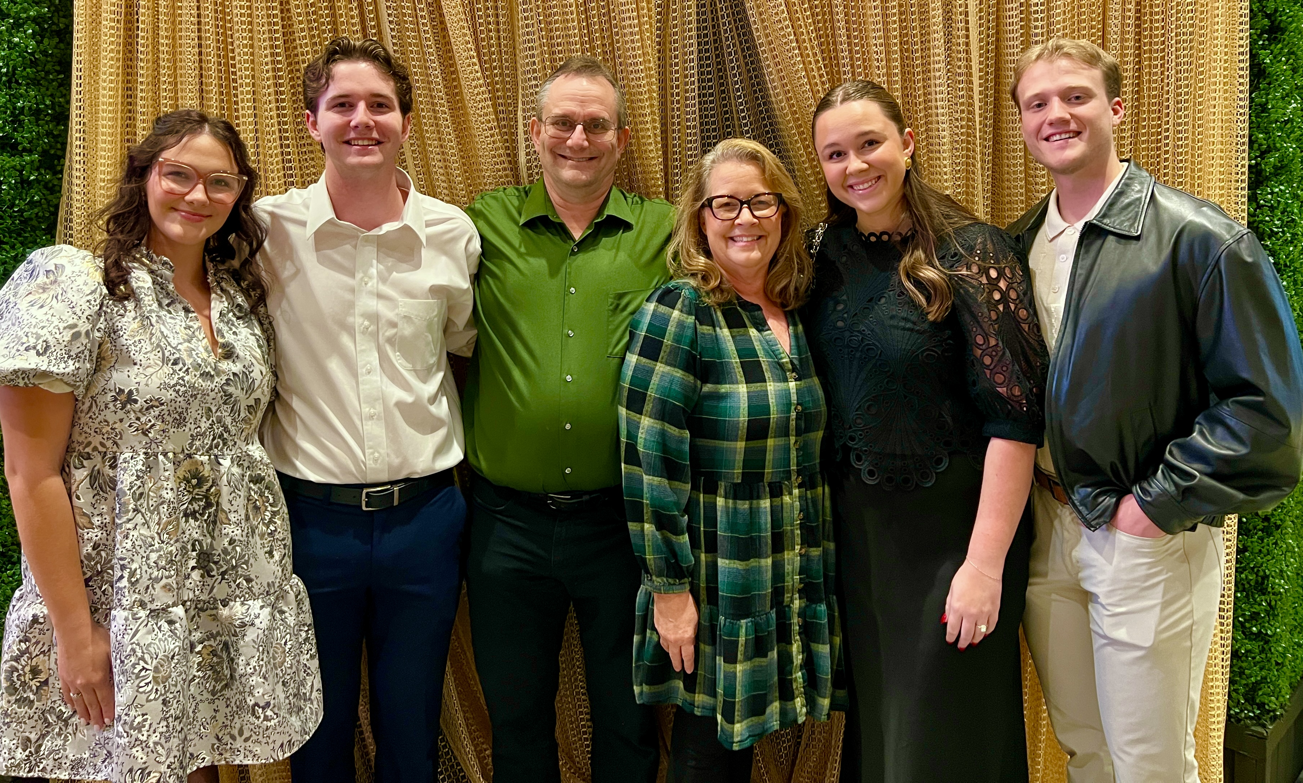
Kylie (future D-I-L), Samuel, Peter, Janet, Bailey, Jett (S-I-L)
Notes:
I am originally from England. A thirty-year engineering career in oil and gas brought me to Louisiana, and when Janet followed me to Africa, I decided she was a keeper. We have lived in Houston for twelve years.
The picture shows our family. Details… Some of you very kindly prayed as we prepared for our daughter’s wedding, which was in June.
We’ve been coming to HFBC for about three years, and joined Third Quarter about a year ago. We love Robert’s teaching, and I apologize for not being Robert, but, as you will see, I have tried to copy how he does his slides!

Slide 4
Questions
Who has been to London?
St. Paul’s Cathedral?
The American Memorial Chapel?

Slide 5
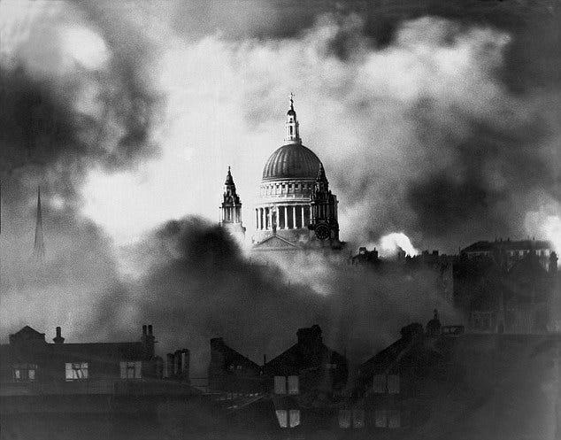
St. Paul’s Cathedral: Symbol of Resistance
Herbert Mason’s image of St Paul’s Cathedral
during the night of 29 December 1940.
Notes:
In 1940, the Blitz was when the Nazis indiscriminately bombed Britain, and especially London, for eight months to destroy morale and cause surrender. Churchill made saving St Paul’s Cathedral a high priority, as it was such a symbol of British resilience against Hitler’s evil. Most of the buildings around St Paul’s were flattened. The photograph shows her dome, standing proud above smoke and flames, during one of those nights. The cathedral survived the war mostly intact.
One bomb hit the target. The Jesus Chapel, at the eastern end of the cathedral, was destroyed on a night in October 1940, before this photograph was taken.
What happened to the destroyed chapel?

Slide 6
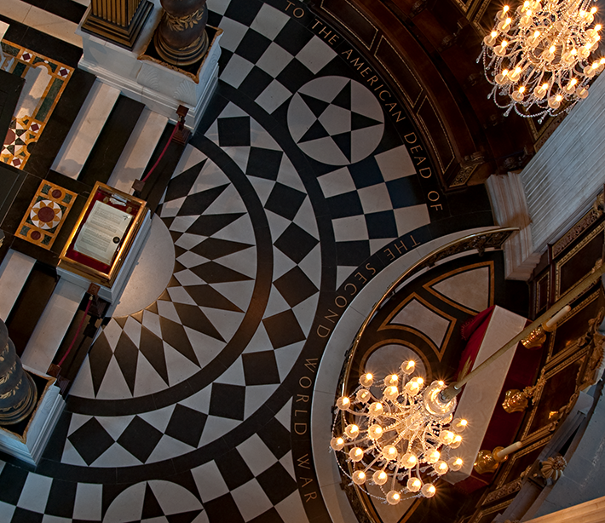
The American Memorial Chapel (Jesus Chapel)
Located behind the high altar, the American Memorial Chapel occupies a privileged position.
The Memorial includes three stained glass panels with biblical images surrounded by the flags of the 48 US states and 4 US territories in existence in 1958.
It was paid for entirely by donations from ordinary British men and women as a heartfelt “thank you.”
Notes:
Engraved on the floor, it says “To the American Dead of the Second World War”
In the center is a roll of honor.

Slide 7
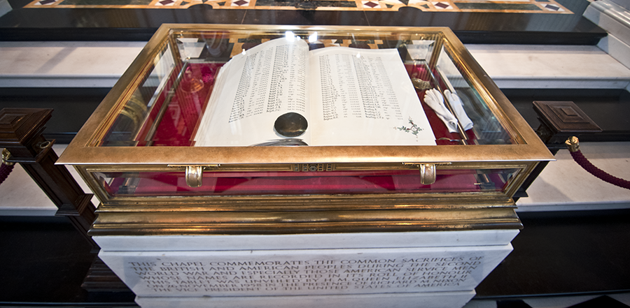
American Memorial Chapel Roll of Honour
The Roll of Honour is a 473-page book with details of 28,000 US soldiers who were stationed in Britain during the war and gave their lives.
Notes:
What did these 28,000 men do? For so many, we don’t know anything more, other than they gave their life. They did many heroic acts, but many of their acts were not recorded, or their records have been lost. Does that diminish their heroism?
Today’s lesson examines a central biblical character, whose potentially most impactful years we know very little about. Peter!

Slide 8
Recap of Peter in the Gospels
Raised as a Jew in Bethsaida (John 1:44) and Capernaum (Mark 1:29)
  As a Jewish fisherman, Judaism was an integral part of Peter’s life.
Called by Jesus (Mark 1:17), who demonstrated His lordship (Mark 1–8)
Peter was the first to recognize Jesus as the Messiah (Mark 8:27–30)
  The vast majority of miracles and parables in Mark occur before this.
  After this, the narrative changes to the road toward Jerusalem and the cross.
Peter made lots of mistakes (Mark 8:33–14:72) but recovered each time.
  Jesus said, “Get behind me Satan,” after Peter rebuked him. (Mark 8:33)
  And beginning to sink he [Peter] cried out, “Lord, save me!” (Matt 14:30)
  When Jesus found Peter sleeping, “Couldn’t you stay awake?” (Mark 14:37)
  “Before the rooster crows twice, you will deny me three times” (Mark 14:72)

Slide 9
Peter in Acts 1-11
Led the new Christian church, transforming it from a church for Jews to a church for everyone.
  Jews and proselytes at Pentecost (Acts 2:9–11)
    Nicolaus the proselyte was the first non-ethnic Jew in leadership (Acts 6:5)
      Peter included Samaritans, despised “half” Jews (Acts 8:5–25)
        Peter baptized Cornelius, the most gentile possible! (Acts 10:48)
        Three accounts in Acts, the same number as accounts of Paul’s conversion.
        Peter told the Jerusalem leadership about gentile salvation. (Acts 11:1–18)

Slide 10
Peter’s Timeline (uses Josephus, 37-100 AD)
These dates have varying degrees of uncertainty.
37-4 BC: Herod the Great ruled Israel
7-5 BC: Birth of Jesus (Gospels), during Herod’s reign (Matt 2:1)
1 AD: Peter born in Bethsaida (John 1:44)
28: Jesus calls Peter to be his disciple (Gospels)
30: Peter’s denial, the crucifixion (Gospels), Pentecost (Acts 2)
30–40: Gospel spread includes non-Jews; Cornelius (Acts 2-11)
41: Acts 12
Notes:
The calendar system that uses AD = Anno Domini, in the year of our Lord, was created in the 6th century by a Roman monk. He had incomplete information about the death of Herod the Great.
The biblical authors were generally not interested in the “when” in the books they wrote, so academics and historians require other primary sources to work out dates.
I’ve covered a lot in summary. Are there any questions or comments on what I’ve said so far?

Slide 11
Acts 12:1-3 (ESV)
1 About that time Herod the king laid violent hands on some who belonged to the church. 2 He killed James the brother of John with the sword, 3 and when he saw that it pleased the Jews, he proceeded to arrest Peter also. This was during the days of Unleavened Bread.
“Herod the king” is Agrippa, Herod the Great’s grandson (v1)
  As a client king, he wanted to show Rome that he had control over Judea.
Killing Apostle James was popular with Jewish leadership. (v3a)
  Who better to kill next than Peter, who was teaching about accepting gentiles?
“Days of Unleavened Bread” and the “Passover.” (v3b)
  One big festival.
  Symbolic execution during the same festival that Jesus was killed eleven years earlier.

Slide 12
Acts 12:4-6 (ESV)
4 And when he had seized him, he put him in prison, delivering him over to four squads of soldiers to guard him, intending after the Passover to bring him out to the people. 5 So Peter was kept in prison, but earnest prayer for him was made to God by the church. 6 Now when Herod was about to bring him out, on that very night, Peter was sleeping between two soldiers, bound with two chains, and sentries before the door were guarding the prison.
“Four squads of soldiers to guard him.” (v4)
  With many sympathizers in Jerusalem; Herod needed to avoid repeating Acts 5:19.
  Four squads to cover four shifts. A squad was four soldiers. Peter was chained to two soldiers, with the other two soldiers at the gate, totaling four soldiers. (vv. 6,10)
The church prays earnestly for Peter. (v5)

Slide 13
Acts 12:7 (ESV)
7 And behold, an angel of the Lord stood next to him, and a light shone in the cell. He struck Peter on the side and woke him, saying, “Get up quickly.” And the chains fell off his hands.
It was night, which would have been dark. (v6)
The angel “struck” Peter. (v7)
  gr:potasso, as in Acts 12:23:
    “Immediately an angel of the Lord struck him [Herod Agrippa] down, because he did not give God the glory, and he was eaten by worms and breathed his last.”
  Peter was sleeping very soundly, awaiting his death -> peace.
    For whoever would save his life will lose it, but whoever loses his life for my sake will find it. Matt 16:25
“Quickly” (v7)
  Urgency to get out of prison to avoid discovery, or to get Peter to obey in his half-sleep.
  The chains!
Notes:
Matthew 16:25: For whoever would save his life will lose it, but whoever loses his life for my sake will find it.

Slide 14
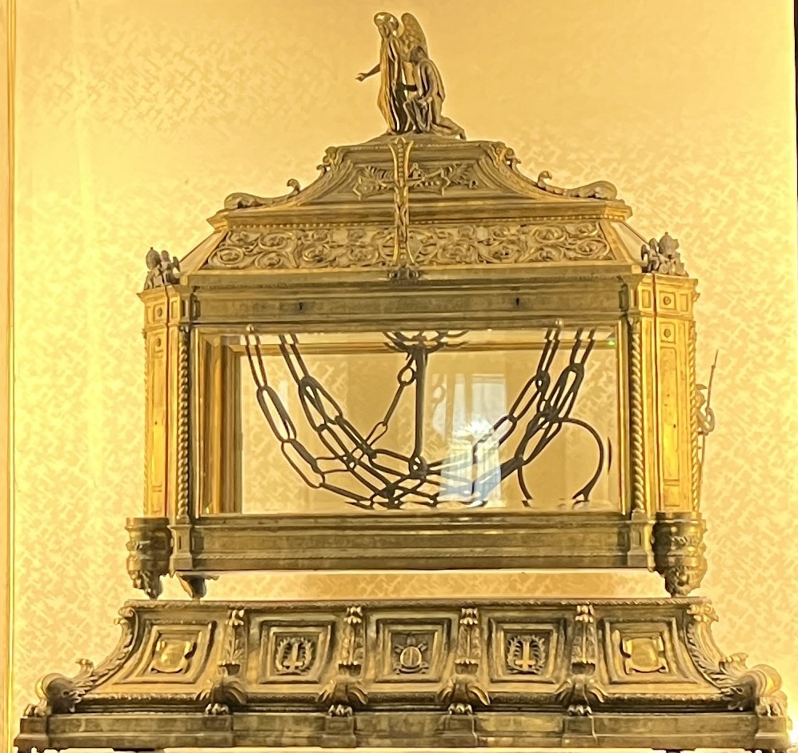
In the St. Peter in Chains Basilica, Rome
  Mirabilia, manuscripts from around 1140 AD which describe Rome’s history, associate Peter’s chains with this basilica.
  The manuscripts explain that Eudoxia, the wife of Roman Emperor Arcadius, founded the church in the early 400’s as a place to keep Peter’s chains, which had been gifted to her on a visit to Jerusalem.
Notes:
This is a great example of “tradition.” Eudoxia was motivated to gain recognition. I don’t believe these are the actual chains, but that does not matter.

Slide 15
Acts 12:8 (ESV)
8 And the angel said to him, “Dress yourself and put on your sandals.” And he did so. And he said to him, “Wrap your cloak around you and follow me.”
“Dress yourself” or “put on your sandals.”
  Parallels the Passover instruction to eat with “your waist girded” (Ex 12:11) = “be ready.”
  Peter likely removed his belt and sandals to sleep. He wasn’t expecting to go anywhere!
Peter had likely removed his cloak or outer garment for comfort or as a pillow.
  He would need it for the chilly outside air. Passover typically occurs around the end of March.
  Remember “Peter warming himself” outside Caiaphas’s house. (Mark 14:67)

Slide 16
Acts 12:9-10 (ESV)
9 And he went out and followed him. He did not know that what was being done by the angel was real, but thought he was seeing a vision. 10 When they had passed the first and the second guard, they came to the iron gate leading into the city. It opened for them of its own accord, and they went out and went along one street, and immediately the angel left him.
Peter thought he was seeing a vision. He’d previously had a vision and escaped jail. (v9)
Passed the first and second guard = consistent with a squad of four. (v10)
The iron gate (v10):
  More robust than the public jail in Acts 5 which is described as having a door.
  “Opened for them of its own accord” = gr: automatos, auto=“self”, matos=“will”.

Slide 17
Acts 12:11 (ESV)
11 When Peter came to himself, he said, “Now I am sure that the Lord has sent his angel and rescued me from the hand of Herod and from all that the Jewish people were expecting.”
Was Peter now sure that it wasn’t a dream, or was he sure of his mission?
  Certainly, he now knew it was not a dream.
  He was expecting death, culmination of ~13 years on mission since meeting Jesus.
    Climaxing in Cornelius’s baptism and the Holy Spirit descending on gentiles.
  “Peter’s miraculous preservation in Acts 12 functions narratively as divine vindication of the mission Peter had just undertaken.”
Notes:
What was it about gentiles? Non-ethnic Jews? No. Receiving God’s favor and grace without obeying the Mosaic Law.

Slide 18
Acts 12:12-14 (ESV)
12 When he realized this, he went to the house of Mary, the mother of John whose other name was Mark, where many were gathered together and were praying. 13 And when he knocked at the door of the gateway, a servant girl named Rhoda came to answer. 14 Recognizing Peter’s voice, in her joy she did not open the gate but ran in and reported that Peter was standing at the gate.
“When he realized this” – I’ve got work to continue! (v12)
Likely a wealthy family: many gathered, door of the gateway, servant. (v12,13)
Peter’s voice was recognized, as at Caiaphas’s house. (Mark 14:70)
Notes:
Why would Peter’s voice have been recognized?
Peter’s rough Galilean accent was distinctive in Jerusalem. Perhaps like mine, here? Or when the Maine mission trip people hear the locals talk about “parking the car in Bar Harbor”

Slide 19
Acts 12:15-16 (ESV)
15 They said to her, “You are out of your mind.” But she kept insisting that it was so, and they kept saying, “It is his angel!” 16 But Peter continued knocking, and when they opened, they saw him and were amazed.
The church had been praying earnestly (v5)
The gathering did not believe Rhoda (v15)
  “You are out of your mind,” “It’s Peter I’m sure,” “It is his angel.”
  “But Peter continued knocking,” perhaps quietly? (v15)
The gathering was amazed that their prayer had been answered. (v16)
  People also “amazed” at Pentecost (Acts 2:7), Holy Spirit on gentiles (Acts 10:45)
Notes:
“the most entertaining scene in the New Testament”

Slide 20
Acts 12:17a (ESV)
17 But motioning to them with his hand to be silent, he described to them how the Lord had brought him out of the prison. And he said, “Tell these things to James and to the brothers.”
“Tell James,” is the first mention of Jesus’s brother in Acts.
  Handover notes to new Jerusalem leadership.
  “I was right to accept gentiles!” which the Jewish Christians had struggled with.
  In the next few years, James writes, “The prayer of a righteous person is very powerful in its effect.” (James 5:16)

Slide 21
Acts 12:17b (ESV)
17b Then he departed and went to another place.
Where did Peter go? What did he do?
  Flee from Agrippa’s jurisdiction and the influence of the Jerusalem Jews ~41 AD
  Peter was with Paul in Antioch 46 AD. (Galatians 2)
  Peter attended the Jerusalem Council ~49 AD. (Acts 15:6-11)
  In 55/56 AD, Paul’s letter suggests that Peter (Cephas) had spent time in Corinth. (1 Corinthians 1:12, 3:22, 9:5, 15:5)
  In early 57 AD, Paul’s letter to the Romans does not mention Peter.
  Peter wrote 1 Peter from “Babylon”, used for “Rome.” (1 Peter 5:13) (~60-63 AD)
  Peter addressed 1 Peter to Pontus, Galatia, Cappadocia, Asia, and Bithynia.
  Peter executed in Rome ~64-65 AD. (Church Fathers, tradition)
Notes:
There are plenty of other speculations about where Peter went, including the real Babylon, and even England!

Slide 22
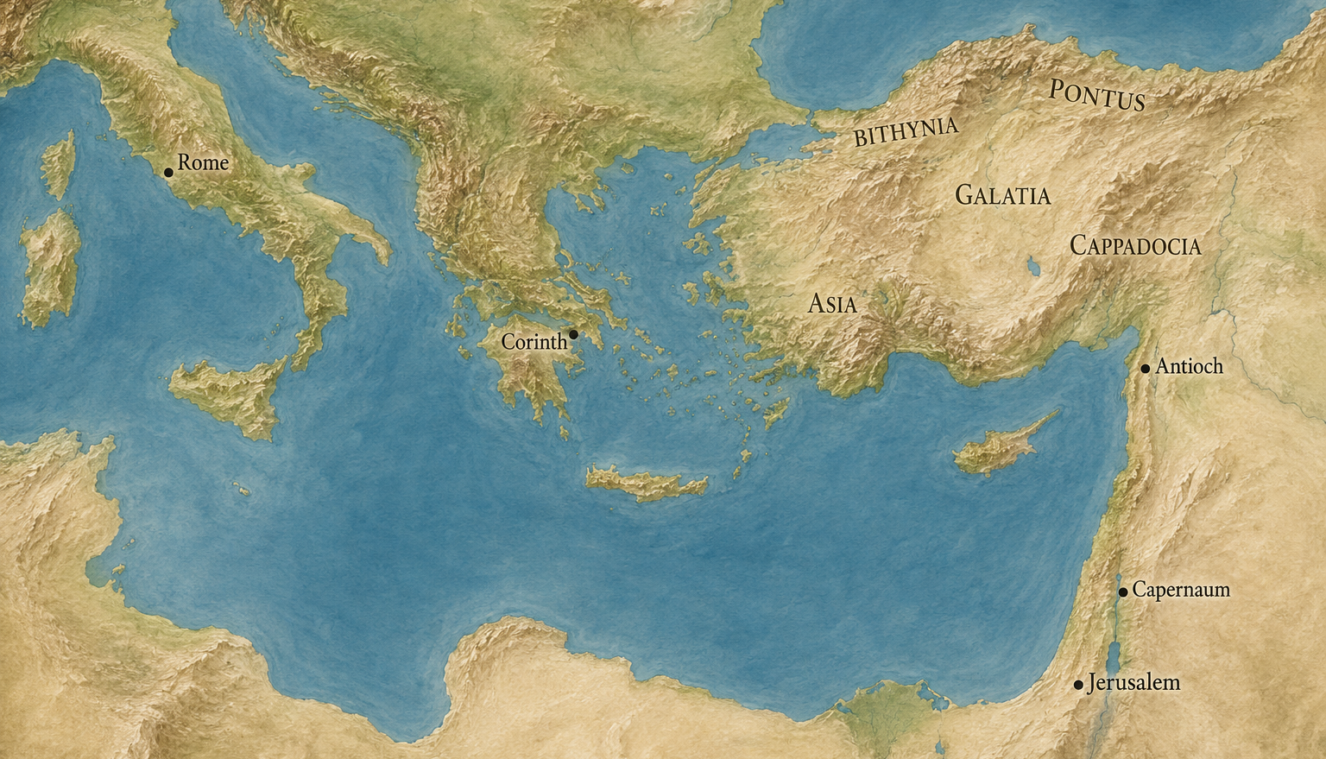
Where did Peter go?
41-64 AD
Notes:
After Peter’s revelation that God had freed him from death at the hands of Agrippa and the Jews.
Similar footprint to Paul’s travels.

Slide 23
Where Did Peter Go, What Did He Do?
Peter’s life:
  0-27: A Jewish fisherman until Jesus called him.
  28-30: Jesus’s lead disciple until Jesus’s crucifixion
  30-41: Led the new church until he baptized Cornelius, then escaped from prison
  41-64: Largely unknown
    Wrote two biblical letters towards the end of this period, 23 years after his life-changing revelation about gentiles.
    Was this period Peter’s Third Quarter?
What happened to Peter in those 23 years? We don’t know!
  Why?
  Who?
Notes:
9.5 minutes from this slide.

Slide 24
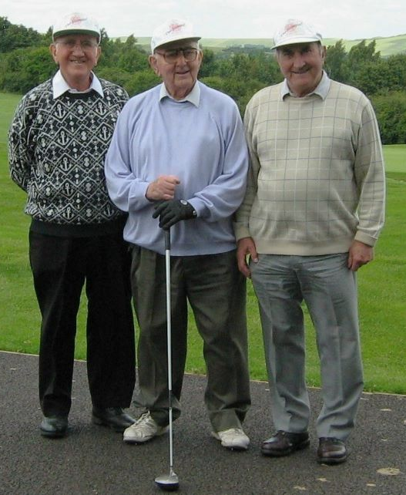
My Uncle Den in WW2
1942: Called up in the army to Fort George, Inverness, for training as a radio operator.
1943: Shipped to North Africa. Joined 16th/5th Lancers at Philippeville (Skikda, Algeria), who had Sherman tanks.
1944: Taken to Naples when the fighting was at Caserta – a bit north of Naples. Saw action around Casino, and on upwards and finally finished in Austria and instead of tanks joined the Lipizzan horses. Appeared in Searchlight Tattoo in the grounds of Schonbrun Palace in Vienna in aid of the children of Vienna.
Den’s favorite tale was about how his photo appeared in a national newspaper in November 1944, showing him bathing naked in an Italian river, “well within the range of enemy shell fire.”
Notes:
7.5 minutes more from this slide.
The photo shows my Dad on our left, his big brother Den in the middle, and little brother Brian on our right. Uncle Den was the only one old enough to serve in the war.
I tried to get Den to tell me details about his time in the war. This is all he would tell me.
Den was a printer by trade. He never had much money. For many years, he cared for his wife Brenda who had her feet amputated due to diabetes. I’m sure he did many other great things. He was such a warm, kind man and was our kids favorite.

Slide 25
Encouragement for Serving Others
“You will be my witnesses in Jerusalem and in all Judea and Samaria, and to the end of the earth.” (Acts 1:8b)
Some service is visible; some is in secret.
  There are many different roles in the body of Christ. (1 Corinthians 12:12–27)
  “And your Father who sees in secret will reward you.” (Matthew 6:6b)
“Honor your father and mother.” (Exodus 20:12a, Ephesians 6:2a)
“Train up a child in the way he should go; even when he is old he will not depart from it.” (Proverbs 22:6)
“In sickness and in health, until death do us part”
Notes:
Acts 1:8 covered by Robert in September last year. Jesus gave us a mission.

Slide 26
Take Aways
Be encouraged when you serve God and no one notices.
  God is watching.
Be encouraged by Peter’s example.
  Learn from your mistakes.
  Recognize God working in your life.
    Peter was not ready to write his epistles until he was over sixty.
  Have faith that prayer works!
  Suggestion: Read Mark, Acts 1-12, and 1 & 2 Peter from Peter’s perspective.
Notes:
Jesus taught us to pray and serve in private.
Peter served silently for 23 years, and then he wrote letters which became Scripture.

