Slide 1
The Unrepentant Prophet
(Jonah 4:1—11)
Peter Ireland
Notes:
Opening prayer.
Thanks for having me as a guest teacher.
I want to share a lesson on the last chapter of Jonah.

Slide 2
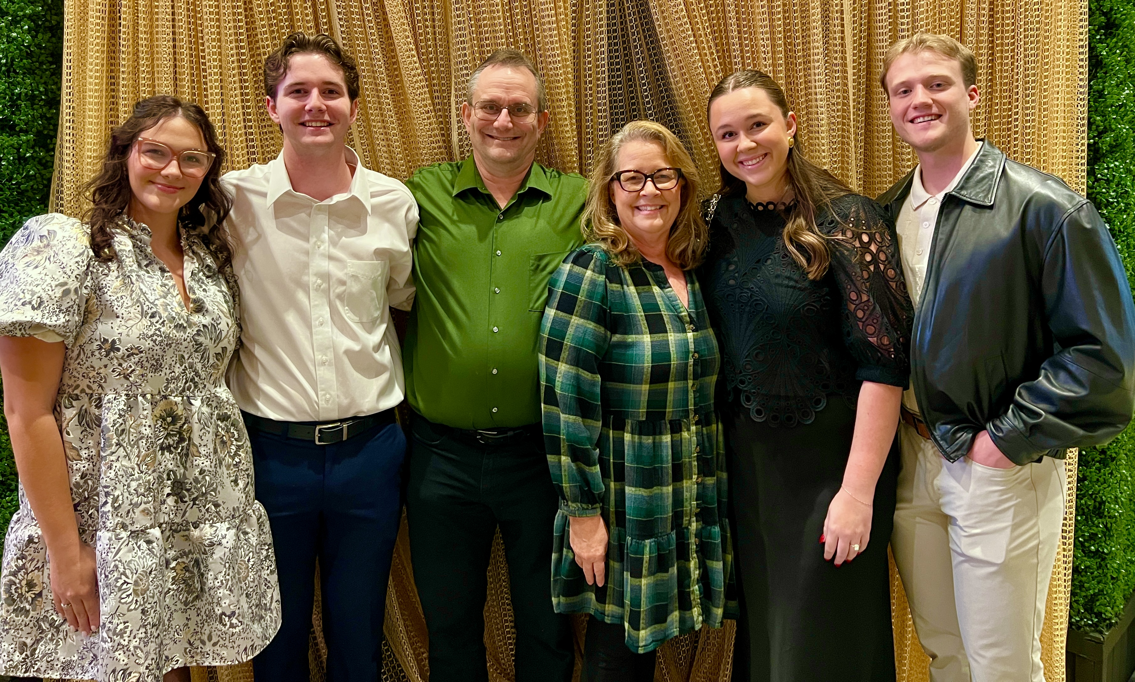
Kylie (future D-I-L), Samuel, Peter, Janet, Bailey, Jett (future S-I-L)
Notes:
I am originally from England, and a thirty-year engineering career in oil and gas brought me to Louisiana, and when she followed me to Africa, I decided she was a keeper.
We have lived in Houston for twelve years.
The picture shows our family.
Does anyone in the room have English ancestry?

Slide 3
Jonah
Anonymous author, date of authorship unknown. Israelite audience.
Unique amongst the prophetic books in a couple of ways:
  The book is a narrative about Jonah’s life, not his prophecy or sermons:
    “In forty days, Nineveh will be demolished!” (Jonah 3:4)
  The only prophet who runs away from God’s mission; a negative example.
Events ~780 BC. In 2 Kings 14:25: [King Jeroboam] restored Israel’s border as directed by God via the prophet Jonah the son of Amittai. Likely experienced.
Exodus
~1466 BC
David
~1000 BC
Fall of Northern Kingdom
~722 BC
Assyria defeated
~612 BC
Exile to Babylon
~586 BC
Jonah (Amos, Hosea)
~780 BC
Nahum
~630 BC
Notes:
I’m really excited to teach about Jonah as studying this book inspired me to dig deeper throughout the Bible.
There is so much more to the book’s concise four chapters than the story of a big fish.
It is a literary masterpiece! I will walk through the fourth chapter, but first I want to provide the book’s context.
Jonah spoke only seven words of prophecy.
Note that Jonah was involved in restoring Israel’s border. Nineveh 6-700 miles from Israel

Slide 4
Prelude: Jonah 3b:4–10(CSB)
Now Nineveh was an extremely great city, a three-day walk. 4 Jonah set out on the first day of his walk in the city and proclaimed, “In forty days Nineveh will be demolished!” 5 Then the people of Nineveh believed God. They proclaimed a fast and dressed in sackcloth—from the greatest of them to the least.
6 When word reached the king of Nineveh, he got up from his throne, took off his royal robe, covered himself with sackcloth, and sat in ashes. 7 Then he issued a decree in Nineveh: By order of the king and his nobles: No person or animal, herd or flock, is to taste anything at all. They must not eat or drink water. 8 Furthermore, both people and animals must be covered with sackcloth, and everyone must call out earnestly to God. Each must turn from his evil ways and from his wrongdoing. 9 Who knows? God may turn and relent; he may turn from his burning anger so that we will not perish.
10 God saw their actions—that they had turned from their evil ways—so God relented from the disaster he had threatened them with. And he did not do it.
In summary: Jonah spoke; Nineveh repented; God relented.
Notes:
4. Nineveh was the capital of Assyria on Israel’s northern border, the northern border of the Northern Kingdom.
Shouldn’t this be a prophet’s dream? He speaks seven words and a great city repents and turns to God?
Let’s see how Jonah reacted to this.

Slide 5
Jonah 4:1–4
1 Jonah was greatly displeased and became furious.
2 He prayed to the Lord, “Please, Lord, isn’t this what I said while I was still in my own country? That’s why I fled toward Tarshish in the first place. I knew that you are a gracious and compassionate God, slow to anger, abounding in faithful love, and one who relents from sending disaster.
3 And now, Lord, take my life from me, for it is better for me to die than to live.”
4 The Lord asked, “Is it right for you to be angry?”
Notes:
On the surface, this makes no sense, as Jonah had just done something great, so let’s unpack it.

Slide 6
The Temper Tantrum (4:1–2)
Jonah was VERY angry, “displeased with great displeasure.”
  He was hot (i.e., furious).
He prayed, mirroring his prayer from the fish’s belly (Jonah 2:2–9)
  Inside the fish: Thanks and promises, but no apology or repentance.
    The prayer includes 24 uses of the first person in 8 verses: I, me, my.
  Now: anger! 7 first persons in 2 verses including “my own country” (4:2).
    “Isn’t this what I said?” reveals the reason for Jonah’s initial fleeing in chapter 1.
      Jonah’s contemporaries (e.g., Hosea) prophesied Israel’s defeat:
        “Assyria will rule over [Israel] because they refuse to repent” (Hos 11:5)
      Nineveh was outside of God’s covenant with Israel.
Notes:
In chapter 1, when Jonah fled, he wasn’t scared of death at the hands of the Ninevites. It was that he didn’t want anything to do with an activity that saved Nineveh.

Slide 7
6b The Lord—the Lord is a compassionate and gracious God, slow to anger and abounding in faithful love and truth,
7 maintaining faithful love to a thousand generations, forgiving iniquity, rebellion, and sin. But he will not leave the guilty unpunished, bringing the consequences of the fathers’ iniquity on the children and grandchildren to the third and fourth generation.
Exodus 34:6b–7
The Lord spoke to Moses after the Golden Calf incident and the writing of the Ten Commandments and the second set of stone tablets.
Notes:
This passage from when Moses met with God to receive the second copy of the Ten Commandments after the Golden Calf incident, which was not Israel’s finest hour.

Slide 8
6b The Lord—the Lord is a compassionate and gracious God, slow to anger and abounding in faithful love and truth,
7 maintaining faithful love to a thousand generations, forgiving iniquity, rebellion, and sin. But he will not leave the guilty unpunished, bringing the consequences of the fathers’ iniquity on the children and grandchildren to the third and fourth generation.
Exodus 34:6b–7
Notes:
Jonah quotes the yellow part of it. Jonah’s complaint is that God’s love is only supposed to be the Israelites, his people!
Divine mercy for the Israelites. Omitting the justice for Israel, while assuming Gentiles will be punished.
This passage is part of the Conditional Covenant that God made with the Israelites at Sinai. It includes Divine Mercy and Divine Justice. God rewards faithfulness, which is the first half, but He disciplines disobedience. Jonah does not include this second half in his complaint!

Slide 9
Jonah’s Death Wish and God’s Question(4:3–4)
Jonah would rather die than live.
  He could not bear to live with his God, whom he sees as breaching His covenant by saving the gentile Ninevites.
God asks him whether his anger is right.
  God’s response is very controlled. He has killed prophets for less (c.f. 1 Kings 13).
  Jonah’s “right” is justice for the Gentiles.
  God’s “right” is compassion and grace, divine mercy, hence “righteous.”
  God’s question remained unanswered.

Slide 10
Who has had a plan that they thought aligned with God’s will, but it did not work out as they intended?
Notes:
This passage from when Moses met with God to receive the second copy of the Ten Commandments after the Golden Calf incident. The whole passage would have been familiar to the audience and is referenced multiple times in the Old Testament. Jonah’s complaint is the God’s love is only supposed to be for us, his people! Left unsaid is that God’s punishment is supposed to be for others, not us. Hosea’s prophecy indicates that Israel continued to be unrepentant., but Jonah is only judging others: Nineveh and God!
Divine Mercy and Divine Justice. A key element of the Mosaic Covenent. God rewards faithfulness but disciplines disobedience.

Slide 11
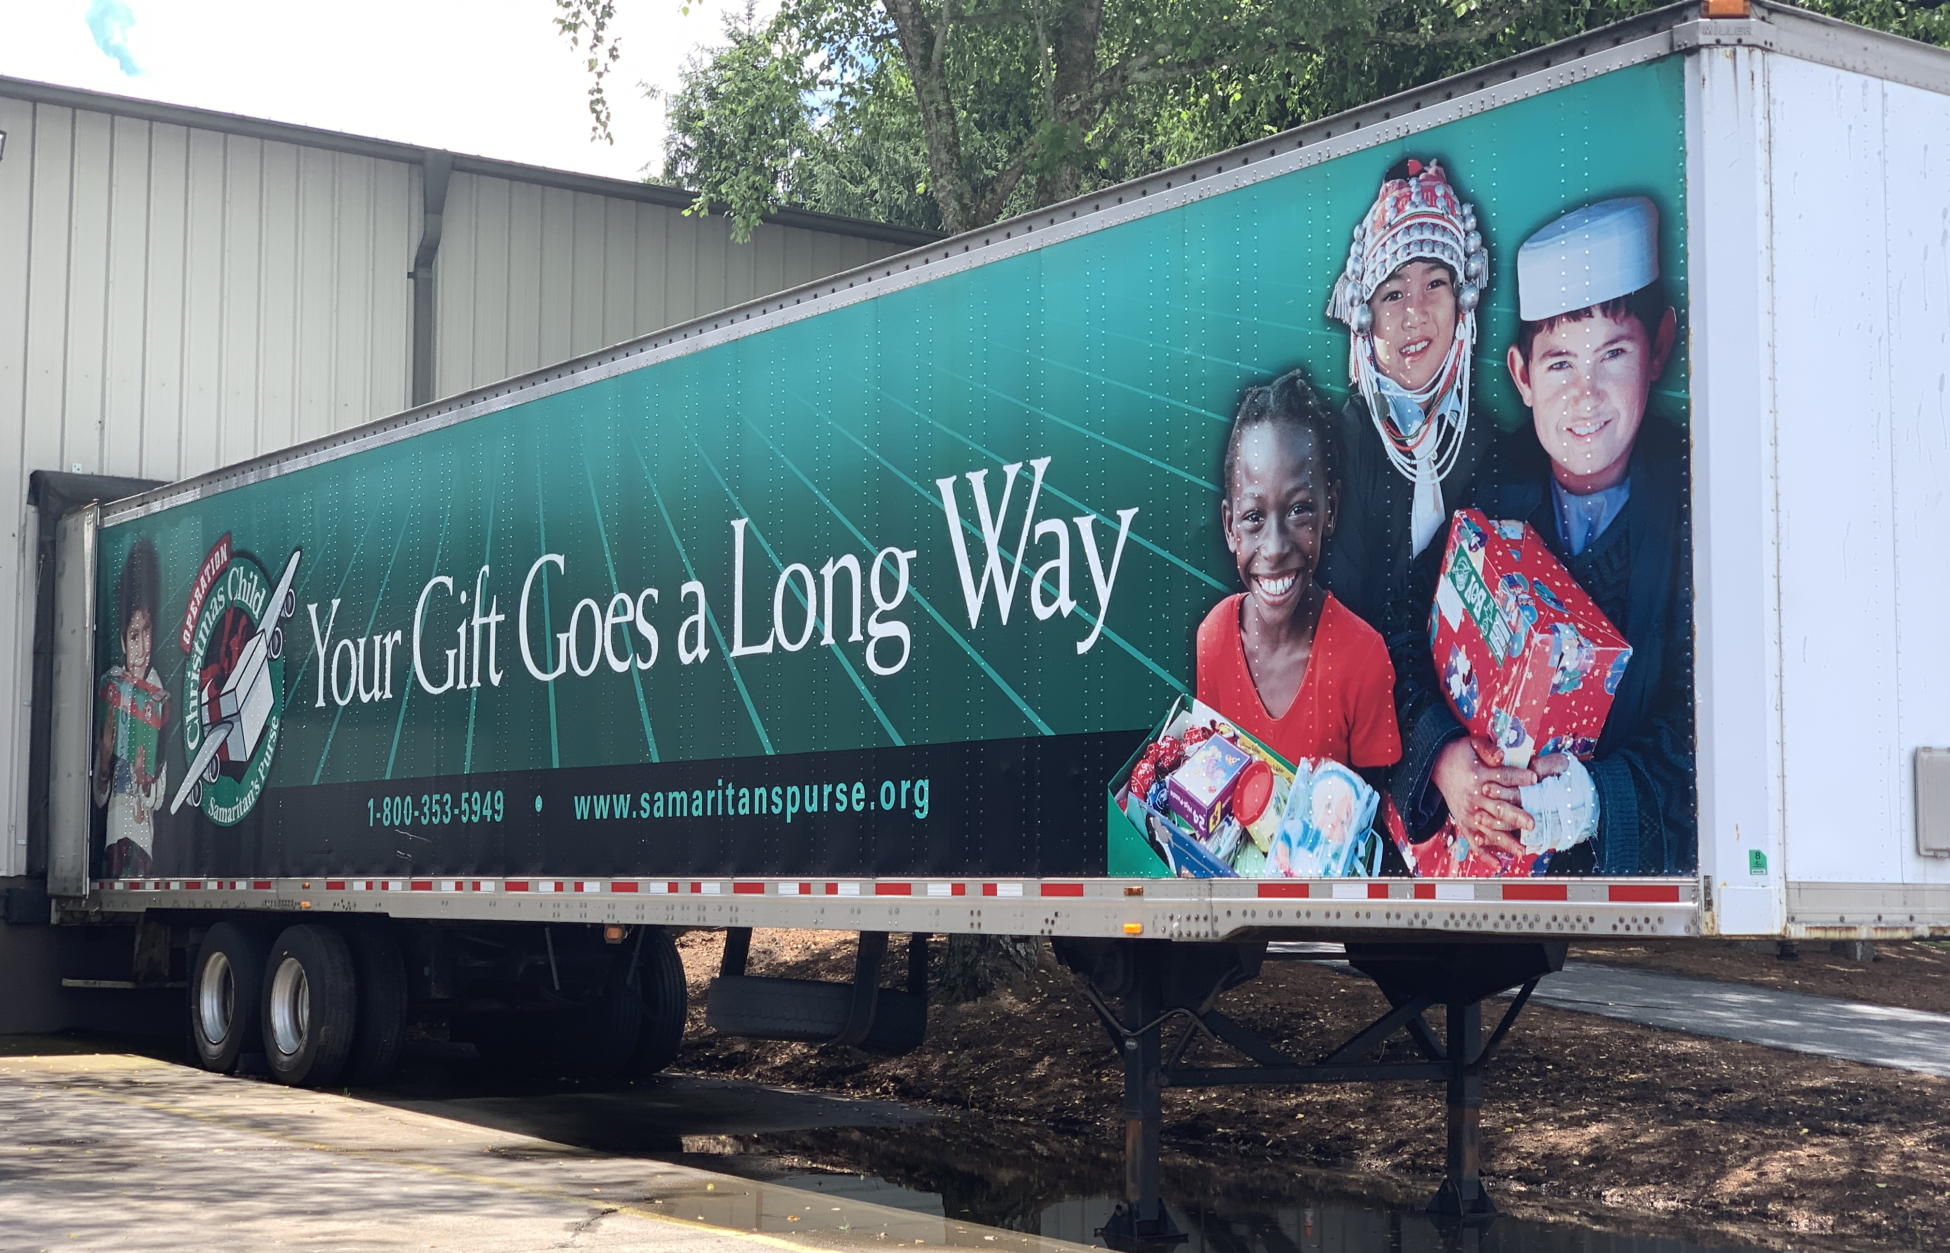
When Things Didn’t Go My Way
Notes:
When I was given the opportunity to retire early from Oil and Gas, I embraced the idea of serving with Samaritan’s Purse in International Disaster Relief, believing my international experience made me a perfect fit. Janet and I had enjoyed sending shoeboxes with their Operation Christmas Child for many years. I applied, and we even thought about moving to their headquarters in Boone, NC. It was an exciting time.
However… in the final interview after an arduous multistage process, when I was about to ask when I’d hear about my first deployment, the interviewer told me, seemingly out of nowhere, that they were going with other candidates. Wow!
It took too long for my ego to recover, and to accept that God had a better plan for me. So let’s look at what Jonah did.

Slide 12
When Things Don’t Go Your Way
Don’t be Jonah:
  Arrogant, self-centered, exclusive.
Ask “Who?” rather than “Why?”
  8 “For my thoughts are not your thoughts, and your ways are not my ways.” This is the Lord’s declaration. 9 “For as heaven is higher than earth, so my ways are higher than your ways, and my thoughts than your thoughts. (Isaiah 55:8–9)
  God’s plan for Nineveh was much bigger than Jonah realized.
    It wasn’t God’s timing for Nineveh to be destroyed yet.
    God was going to use Nineveh to punish Israel’s disobedience, divine justice.
    If we try to understand God fully, we risk putting him in a manmade box.
  Alternative to Jonah’s self-centered prayer is PRAY=Praise, Repent, Ask, Yield.
Notes:
After God’s plan for Nineveh:
If we try to understand God fully and explain everything about him, we put him into a manmade box. We risk creating a God in our image, forgetting that God made us in his image.
I like the PRAY acronym because it’s easy to remember!
Let’s see what happens after God challenged Jonah.

Slide 13
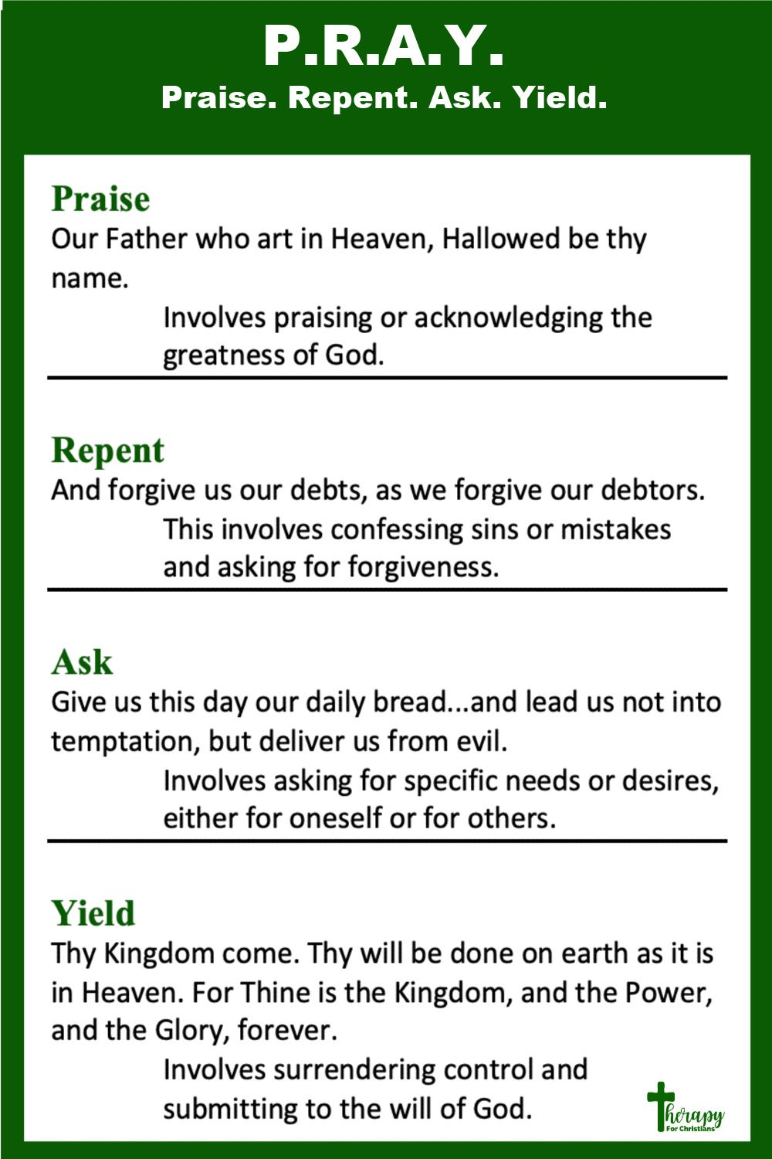
When Things Don’t Go Your Way
Notes:
Next slide – now Let’s see what happens after God challenged Jonah’s angry reaction to things not going his way.

Slide 14
Jonah 4:5–9
5 Jonah left the city and found a place east of it. He made himself a shelter there and sat in its shade to see what would happen to the city.
6 Then the Lord God appointed a plant, and it grew over Jonah to provide shade for his head to rescue him from his trouble. Jonah was greatly pleased with the plant.
7 When dawn came the next day, God appointed a worm that attacked the plant, and it withered.
8 As the sun was rising, God appointed a scorching east wind. The sun beat down on Jonah’s head so much that he almost fainted, and he wanted to die. He said, “It’s better for me to die than to live.”
9 Then God asked Jonah, “Is it right for you to be angry about the plant?” “Yes, it’s right!” he replied. “I’m angry enough to die!”

Slide 15
To the Desert (4:5)
Jonah’s response to God’s question was to run away (again!)
  “East” = Opposite direction of Tarshish
  Hot, arid desert = Opposite to the rough sea in his previous flight
    Shelter or booth, as in the feast which commemorates Sinai desert Lev 23:40–43
    The “booth” was meant for communal joy, not a private viewing stand.
  Why did Jonah want to watch the city?
    Hoping God might change his mind?
    Hoping the Ninevites would quickly stumble, bringing down judgment?
Notes:
Don’t mention the slide title.

Slide 16
The Desert
Has anyone experienced heat exhaustion in a desert?

Slide 17
The view from the Chisos Mountains South Rim in Big Bend National Park
Notes:
One of my favorite places in Texas is Big Bend National Park. This photo is from the park’s Chisos Mountains, looking across the Chihuahuan Desert toward the Rio Grande and Mexico.
I enjoy backpacking, and one of my bucket list trips is here: the 30-mile Outer Mountain Loop, which takes about three days. It starts in the mountains where I took this photo, and it includes a full day’s hiking through this desert below. That section of the loop is called The Dodson, and it is famous for being dangerously hot with no shade.

Slide 18
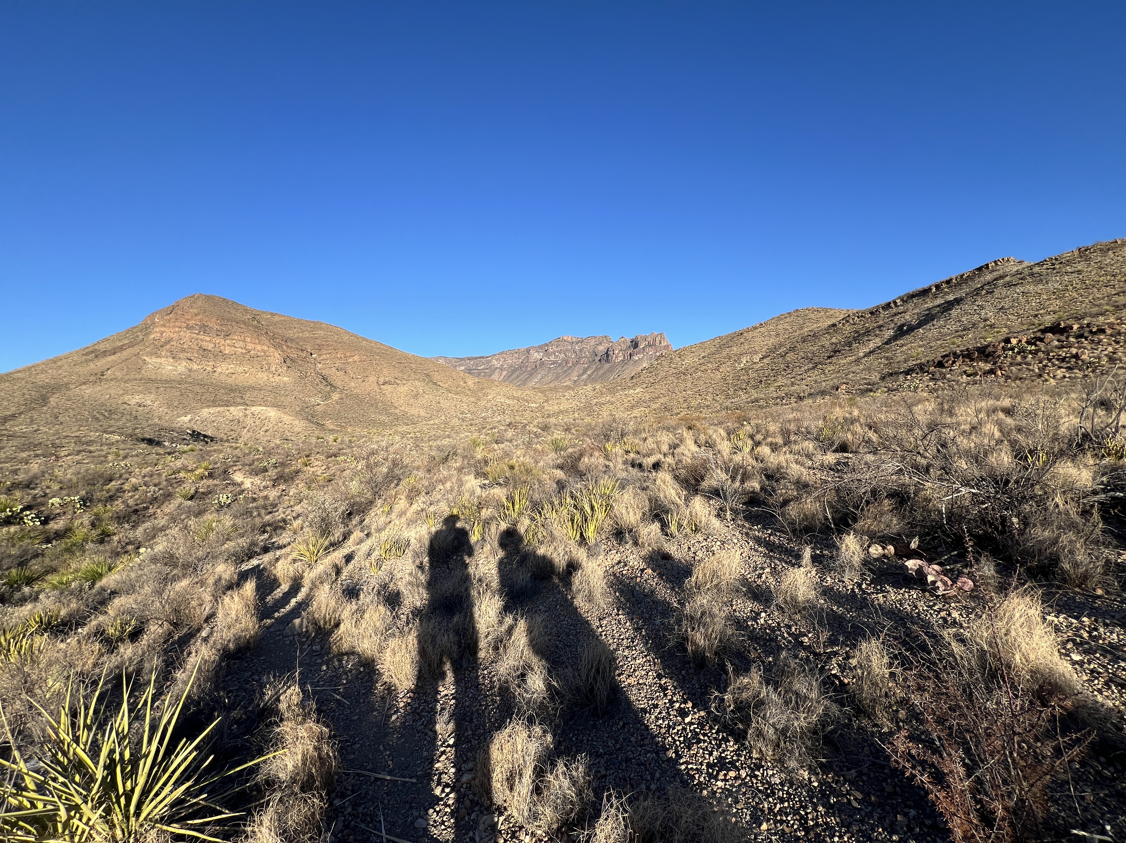
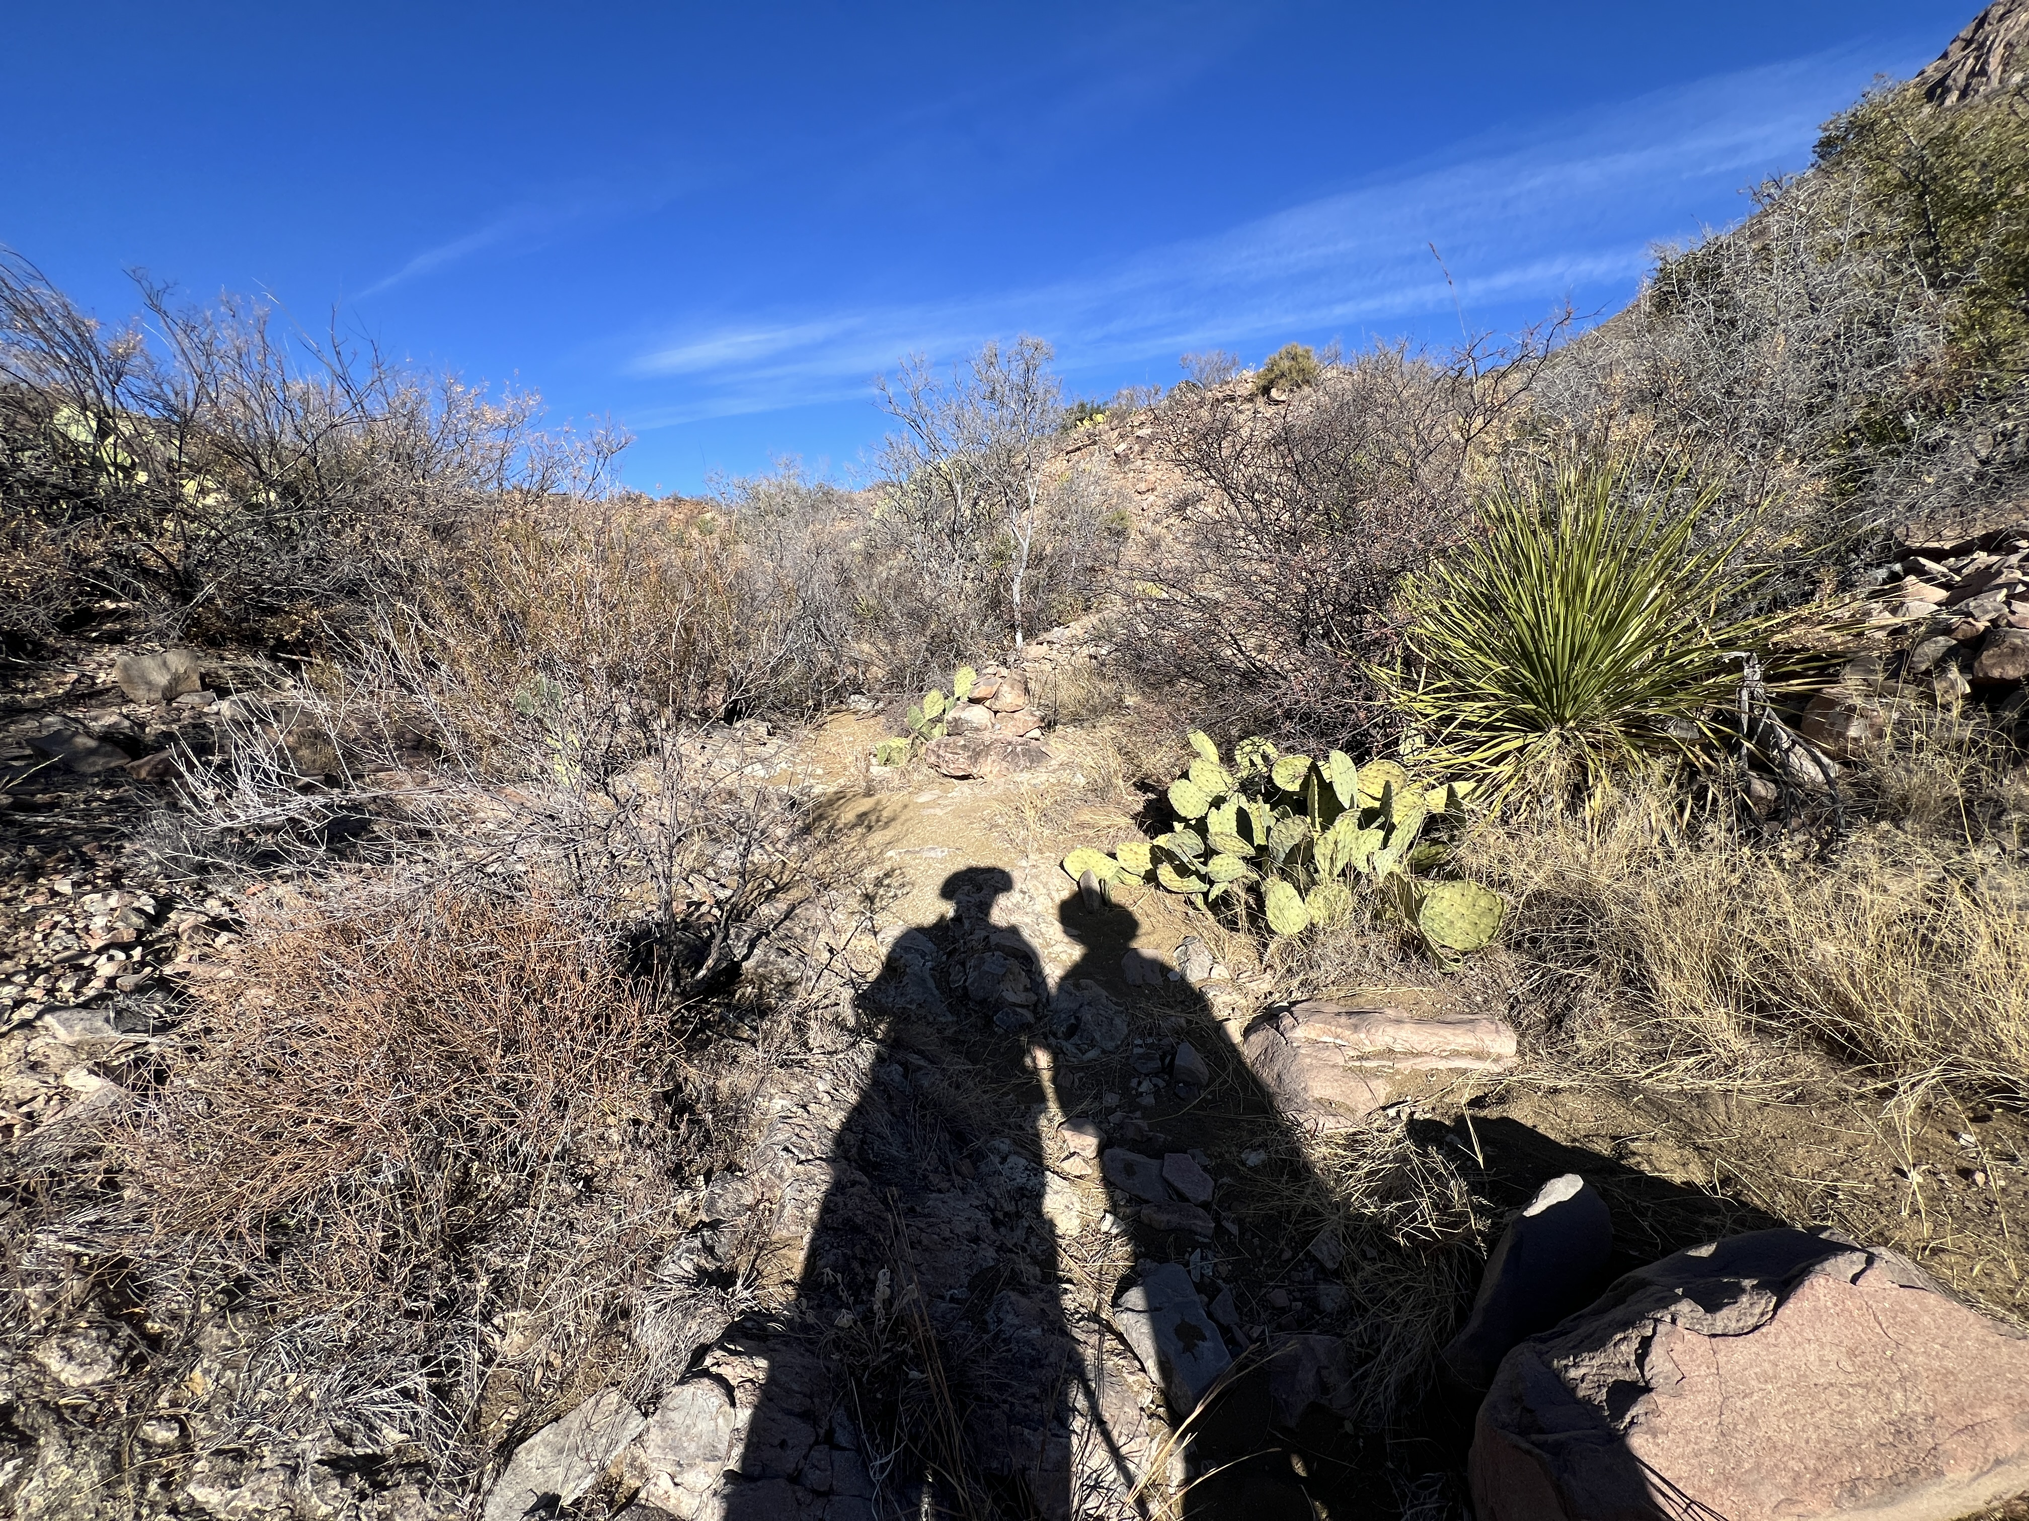
Hiking along The Dodson Trail on the Outer Mountain Loop
Notes:
Close up, this is what The Dodson looks like. In the picture on the left, you can see the mountains in the background which is from where I took the previous photo.
This rocky landscape is very similar to the Sinai Desert. Look at the vegetation. Can you imagine trying to make a shelter out of thorny bushes and cactus plants? In the photos, you will notice our long shadows. That is because it is early in the day and we had started hiking before dawn to beat the heat.
We had followed the Park Rangers’ guidance and were able to avoid hiking in the heat of the day, but each year, several hikers need to be rescued with heat exhaustion, or worse.

Slide 19
The Plant Grows (4:6–7)
4:6 God grows a plant to provide shade for Jonah.
  Suggests the inadequacy of Jonah’s shelter. Shade suggests God’s protection.
  Illustrates God’s divine mercy, but there is no recognition from Jonah.
Repetitions in this passage provide emphasis.
  God “appointed” the plant, like he appointed the fish, the worm, and the wind.
  “rescue him from his trouble”: physical suffering and evil heart, like evil Ninevites.
  Jonah was VERY happy “rejoiced with great joy” contrasts his anger about Nineveh.
4:7 God waited until dawn before appointing the worm.
  God gave Jonah time to change his heart before his next action.
  The worm attacks the plant. Jonah believes Nineveh will attack Israel.
Notes:
After “no recognition from Jonah,” The book’s initial audience, the Israelites from Judah, would have been very familiar with deserts and would have known how
Previously, Jonah had been “displeased with great displeasure.”
In this passage, narrative.

Slide 20
The Plant Dies (4:8–9)
“As the sun was rising” – approaching noon, getting hotter and hotter
  God appoints the scorching wind, mirroring Jonah’s “hot” anger.
  God uses the wind again, as in Jonah 1:4, with the ship.
  This wind “attacks” Jonah’s head; Jonah had wanted God to attack Nineveh.
  His physical suffering now leads him to wish to die.
God again asks Jonah whether it is right for him to be angry.
  Jonah was very happy with Divine Mercy, extremely angry at Divine Judgment.
  In contrast, what did Job do when he suffered?
    “The Lord gives and the Lord takes away. Blessed be the name of the Lord.”
    (Job 1:21)
Jonah remains self-centered, unthankful, and unrepentant.
Notes:
Extreme physical suffering might lead Jonah to reflect on his actions.
At the end of the slide.
Let’s move to the final scene.
How does God respond to Jonah? He tries to explain his position to Jonah.

Slide 21
Jonah 4:10–11
10 And the Lord said, “You cared about the plant, which you did not labor over and did not grow. It appeared in a night and perished in a night.
11 So may I not care about the great city of Nineveh, which has more than a hundred twenty thousand people who cannot distinguish between their right and their left, as well as many animals?”

Slide 22
God’s concluding words (4:10–11)
God explains the contrast between Jonah’s angers.
  4:10: Jonah’s current anger is something that only impacts himself.
  4:11: Jonah’s previous anger toward God is about many people in a huge city.
“Cannot distinguish between their right and their left”
  Idiom for spiritual blindness: “Be careful to do as the Lord your God has commanded you; you are not to turn aside to the right or the left.” (Deut 5:32)
  The Ninevites were naïve and didn’t understand, Jonah did not have that excuse!
God’s mirrors the Ninevite King’s inclusion of the animals in Jonah 3:8.
Notes:
In His conclusion, God compares
End of the slide.
So what happens next? We don’t know; the author leaves us hanging.

Slide 23
The Unfinished Story
No response from Jonah is recorded.
New Testament Parallels:
  The brother’s reaction to the mercy that his father shows to the prodigal son.
    31 “‘Son,’ he said to him, ‘you are always with me, and everything I have is yours.
    32 But we had to celebrate and rejoice, because this brother of yours was dead and is alive again; he was lost and is found.’” (Luke 15:31–32)
  Therefore, consider God’s kindness and severity: severity toward those who have fallen but God’s kindness toward you—if you remain in his kindness. Otherwise you too will be cut off. (Romans 11:22)
  The Lord does not delay his promise, as some understand delay, but is patient with you, not wanting any to perish but all to come to repentance. But the day of the Lord will come like a thief. (2 Peter 3:9–10a)
Notes:
The prodigal son’s brother could not understand how his father could forgive his brother who had sinned so much. Like at the end of Jonah, Jesus leaves his audience hanging at the end of this parable.
In his letter to the Romans, Paul reminds his readers of God’s divine mercy and divine judgment.
Peter concludes his second letter with encouragement about God’s patience, but His judgment is inevitable.

Slide 24
Take Aways
Read the whole book of Jonah. ~1,000 words, 10 minutes.
Look for God when your best-laid plans go awry.
  What bigger plan might God have?
Remember that God’s ways are not our ways.
  God’s ways include Divine Mercy and Divine Justice.
PRAY unselfishly. Praise; Repent; Ask; Yield.

